Slide 1
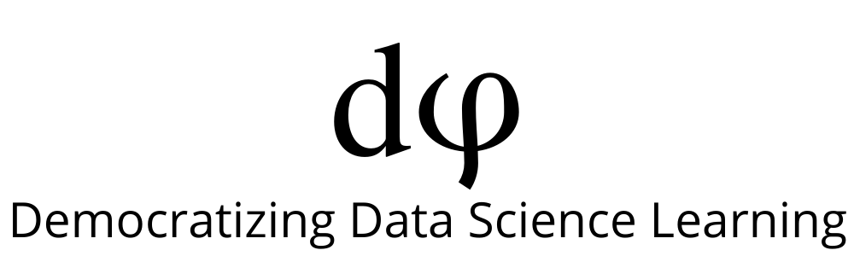
Welcome to Data Science Online Bootcamp
Week#5_Day#1

Slide 2

Learning Objectives
Input variables, target variable, train and test data intuition and Building a ML Model

Slide 3
Context
In this module, we will give a quick recap that would help you to solidify the concepts that you learnt so far with some intuitive examples. This will be focused more towards Model Building

Slide 4
Building a ML Model (Quick Recap)

Slide 5
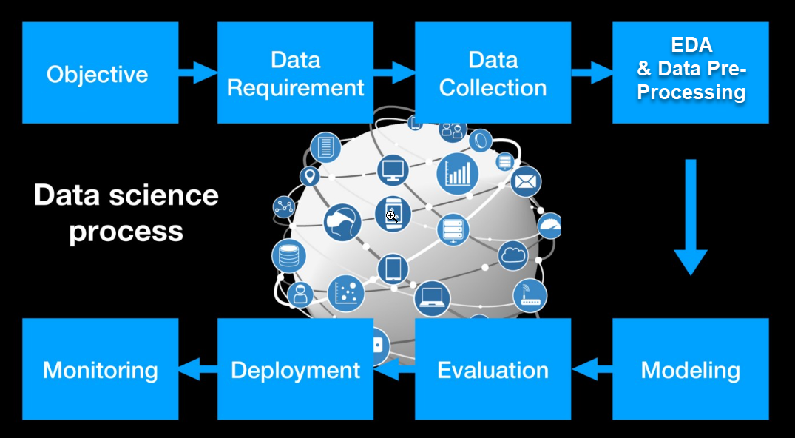
Data Science Modeling Process
+ Data Preprocessing
Credits: https://towardsdatascience.com/data-science-modeling-process-fa6e8e45bf02

Slide 6
Problem Solving Steps
Define Objective or understand the problem statement
Data Requirements
Data Collection/Preparation
Exploratory Data Analysis
Data Pre-processing
Build a model
Understand whether it is a regression or classification problem
Evaluate
Optimise
Production
Monitor
You keep Optimising it every now and then

Slide 7
Problem Statement
HR department wanted to seek support of analytics team to get possible salary predictions give they have information about employees Career Seniority Level and years of experience.
In other words, they need a machine learning model that would predict the possible salary that one should be provided if they feed information about their seniority level and years of experience.
Years of experience
Model
Salary
Seniority level

Slide 8
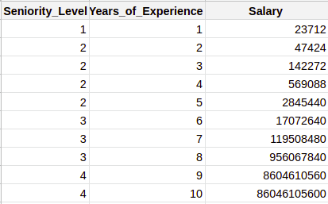
Data Preparation
Given that, we have a problem of predicting the salary of a person based on years of experience.
We have a dataset that looks like:
What features do we have here?
We have 3 features: Seniority_Level, Years_of_Experience and Salary.

Slide 9
Data Preparation
What do you think our target variable(value to be predicted) will be in this case?
Since Salary needs to be predicted, our model will take that to be the target variable and the rest (Seniority_Level, Years_of_Experience) as input variables.
In short, we’ll predict the target variable using input variables.
INPUT VARIABLES (X) TARGET VARIABLE (y)

Slide 10
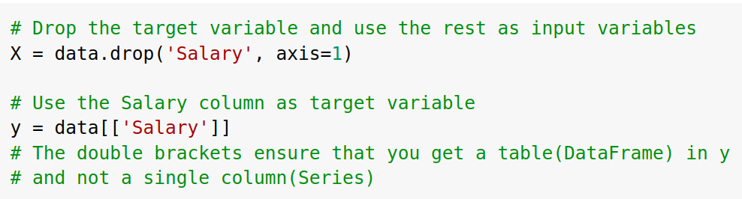
Separating input and target variable
Now how do you actually separate the input and target variables?
Since there’s only one target variable in the DataFrame, we can simply drop it and choose the rest of the variables. We do this using the drop( ) function by simply providing column name inside it.

Slide 11
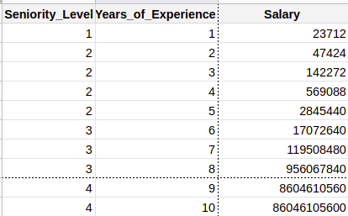
Train and Test Data
Another data splitting that we need to do is dividing the data into Train and Test Sets.
Imagine drawing a horizontal line between the table, let’s say, after the 8th entry. That’s what Train Test Split looks like. The whole table is now divided into 4 parts.
PLEASE NOTE: The dataset should always be shuffled before splitting.
We’ve used an unshuffled version here just for the explanation purpose.

Slide 12
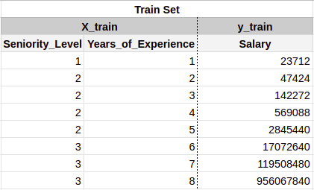
Train and Test Data
The upper part of the table becomes the Train Set which consists of X_train
(The input variables) and y_train (The output variable).

Slide 13
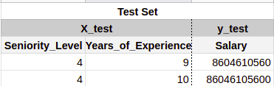
Train and Test Data
The lower part of the table becomes the Test Set which consists of X_test
(The input variables) and y_test (The output variable).

Slide 14
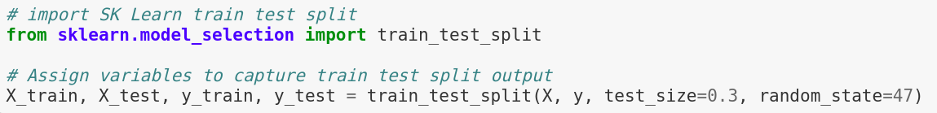
Train_Test_Split
The sklearn’s function used for splitting the dataset is known as train_test_split
The 4 variables that we learned about in the previous slides are assigned values using the above piece of code. Let’s understand what the values inside the brackets mean:
X = Input variables
y = Target variable
test_size = The ratio of the dataset that’ll be used in test set. If there are 100 rows, 70 rows will be used in train set and 30 in test set.
random_state = It is provided just for the sake of obtaining the same result every time we run the code. It ensures that the rows in train and test set remain same each time.

Slide 15
Understanding the type of problem
For understanding the type of problem, we need to see the target variable we are dealing with.
What kind of variable is Salary?
Does it have classes? No, right?
Salary is numerical and different salaries are not divided into classes but are rather continuous values.
The technique used for determining relationship between the input and target variables where the target variable is numerical (or continuous) is known as Regression.

Slide 16
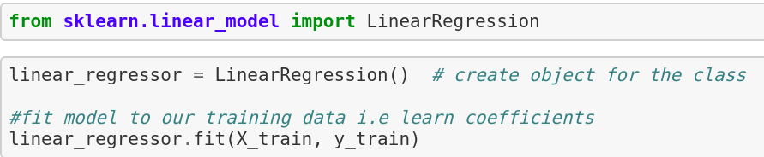
Model Building
Let’s build the simplest of all regression models using Linear Regression now.
Import the model from sklearn
Initialise and store the model in a variable (linear_regressor in this case)
Train the model on Train Data(X_train and y_train) using the fit method.

Slide 17


Model Evaluation
Our model has been created! But how do we know if it works well? By testing it on the Test Data we created.
Remember the test data is also split into 2 parts - X_test and y_test?
We’ll first put the X_test(input variables) in our model and see what Salary predicts for those input values. The actual values of the salaries(y_test) are not shown to the model.
Let’s say our model predicts the following salaries:
This prediction is done using the predict function of sklearn. Inside the predict function, we’ll provide X_test to the model.

Slide 18

Model Evaluation
To know how good these predictions (y_pred) are, we’ll have to compare them to the actual salary values (y_test).
ACTUAL VALUES PREDICTED VALUES
There are a lot of evaluation metrics for regression problems. Let’s use Root Mean Squared Error for this case.

Slide 19
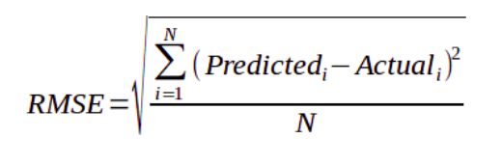

Root Mean Squared Error (RMSE)
It is just the square root of the mean square error.
It is preferred more in some cases because the errors are first squared before averaging which poses a high penalty on large errors. This implies that RMSE is useful when large errors are undesired.
For using RMSE, we’ll first import metrics library from sklearn.
RMSE is not present as a function in sklearn. So we’ll just use the mean_squared_error function and take its square root . The main thing to note is what we provide inside the function - y_test (actual value) and y_pred(predictions made by our model).

Slide 20
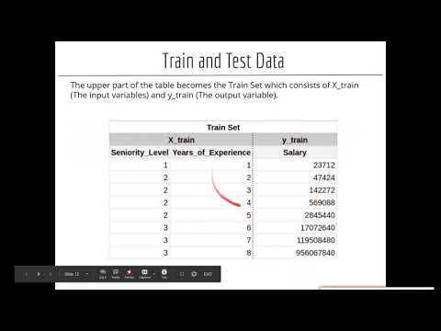
Video Tutorial

Slide 21
Transformations on Train and Test
Now let’s say we performed some feature selection techniques and found out that Seniority_Level is not an important feature, the model can perform better when only Years_of_Experience is used.
We’ll then transform our train data to a dataset with only Years_of_Experience as input variable to predict our target variable Salary.
Now what about test data? Should we remove the Seniority_Level feature from that as well?
The answer is yes.
The Train and Test data must undergo the same data preparation steps. Otherwise, the predictive model will not make sense. This means that the number of features for both the training and test set should be the same and represent the same thing.
Similarly, if normalization is required, then it should be done on both the train and test sets.

Slide 22
Can we normalize and then split?
A question often arises. Can we first normalize the data and then split into train and test sets? Why is there a need of extra efforts to normalize them separately?
The best practice is to use only the training set to figure out how to scale / normalize, then blindly apply the same transform to the test set.
For example, say you're going to normalize the data by removing the mean and dividing out the variance. If you use the whole dataset to figure out the feature mean and variance, you're using knowledge about the distribution of the test set to set the scale of the training set - 'leaking' information.
The right way to do this is to use only the training set to calculate the mean and variance, normalize the training set, and then at test time, use that same (training) mean and variance to normalize the test set.

Slide 23
Slide Download Link
You can download the slides here:
https://docs.google.com/presentation/d/1laaCx6cPS011ARjeY2OemtuyFtX37UlhKIIm_ciqWvg/edit?usp=sharing

Slide 24
That’s it for the day. Thank you!
Feel free to post any queries in the #help channel on Slack

